Slide 1


CS457 digital image processing
LAB 1
Image Enhancement (Point Processing)

Slide 2
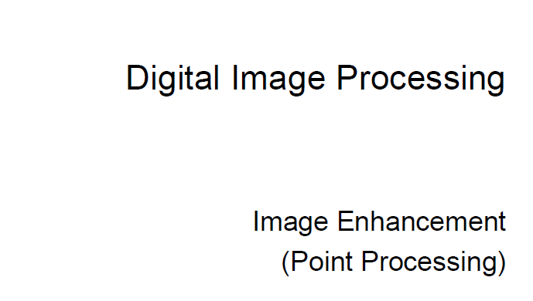
Basic Spatial domain image enhancement
Lab 1

Slide 3
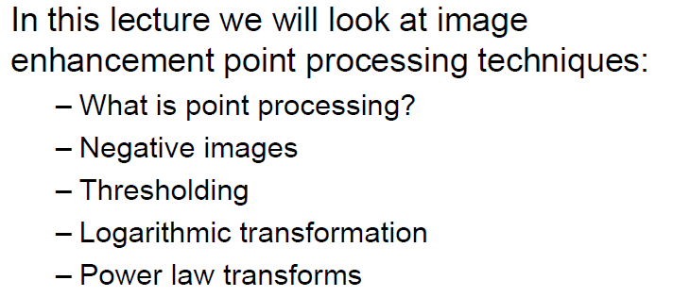
lab 1
Point processing
Explanation

Slide 4
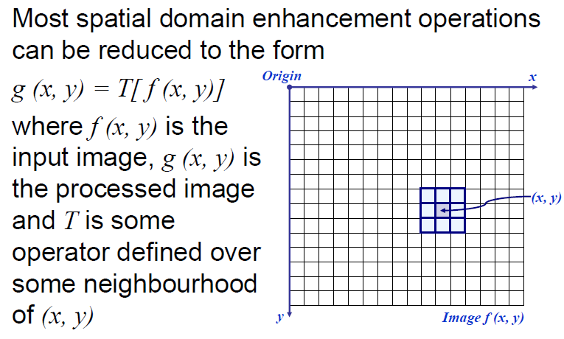
lab 1
Basic Spatial domain image enhancement
Explanation

Slide 5
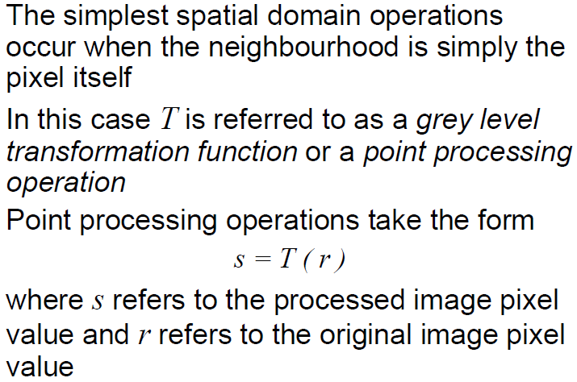
lab 1
Point processing
Explanation

Slide 6
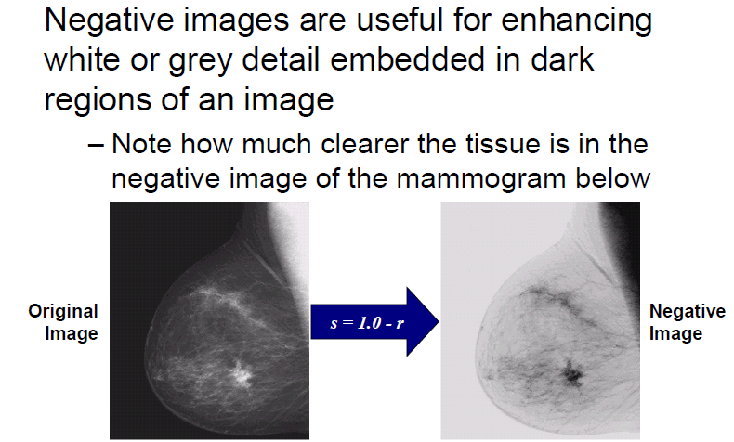
lab 1
Negative image
Explanation

Slide 7
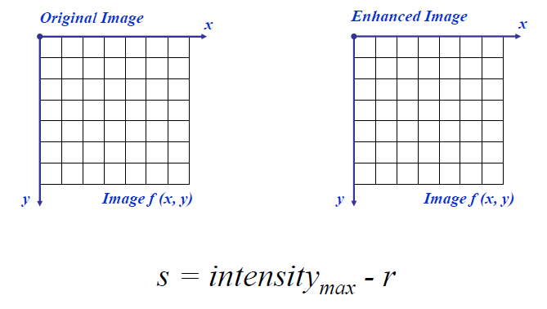
lab 1
Negative image
Explanation

Slide 8
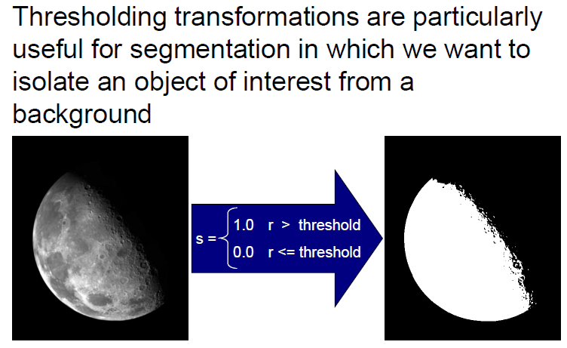
lab 1
thresholding
Explanation

Slide 9
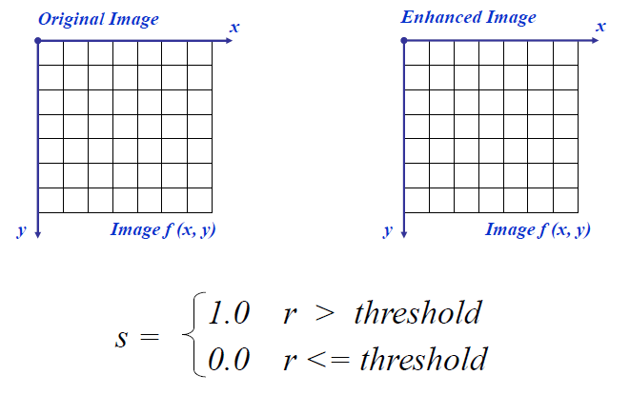
lab 1
thresholding
Explanation

Slide 10
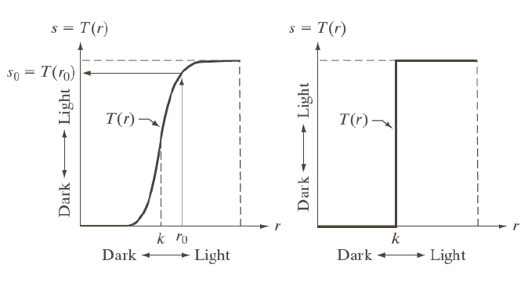
lab 1
Intensity transformations
Explanation

Slide 11
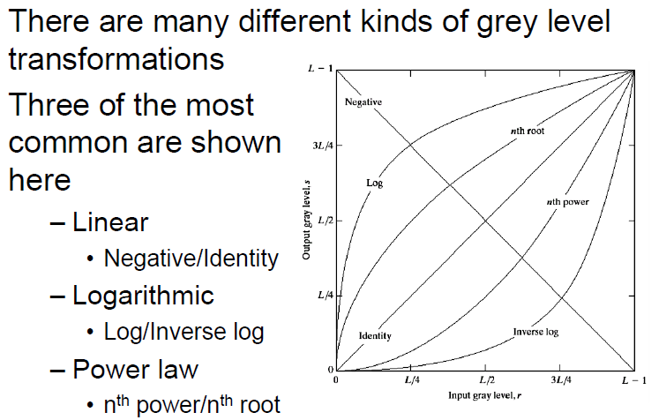
lab 1
Gray level transformations
Explanation

Slide 12
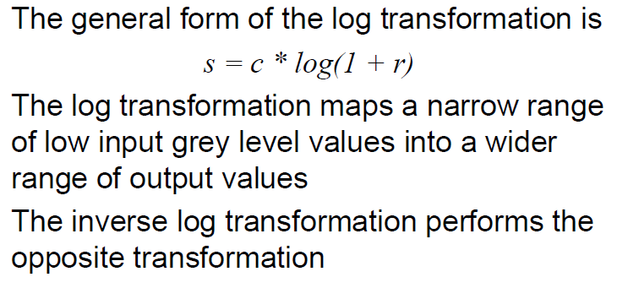
lab 1
Logarithmic transformations
Explanation

Slide 13
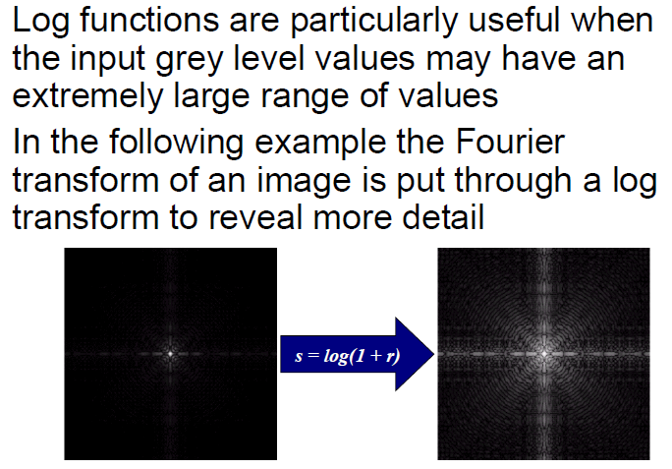
lab 1
Logarithmic transformations
Explanation

Slide 14
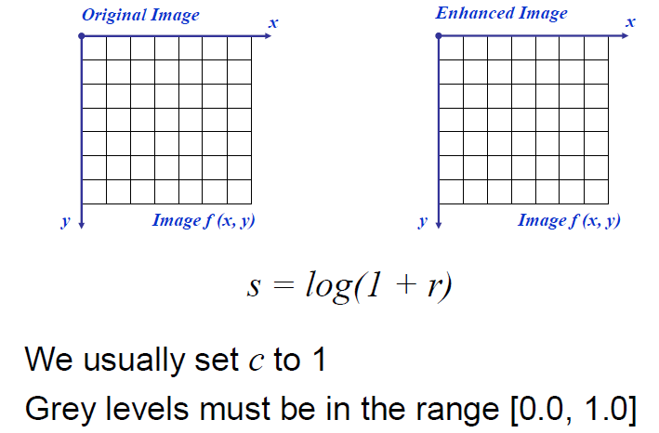
lab 1
Logarithmic transformations
Explanation

Slide 15
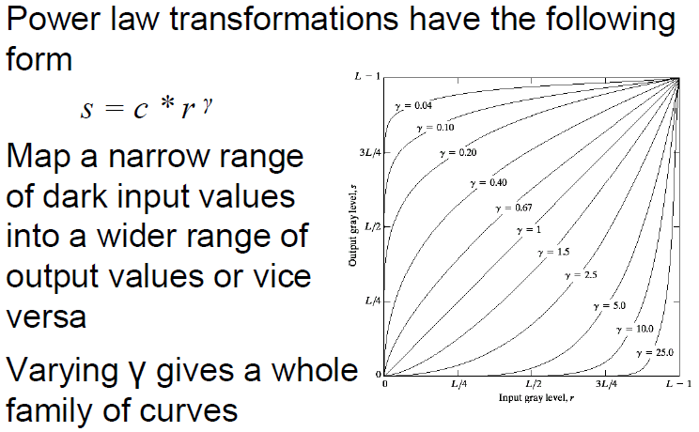
lab 1
Power law transformations
Explanation

Slide 16
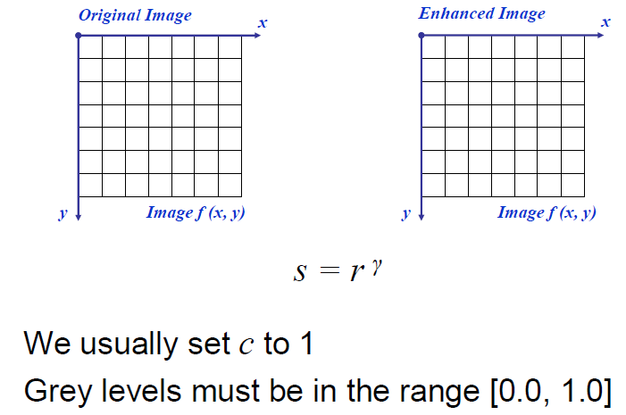
lab 1
Power law transformations
Explanation

Slide 17
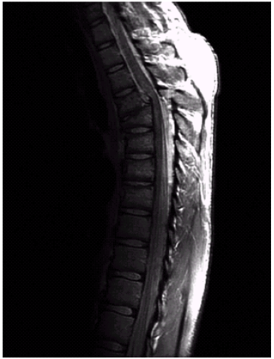
Power law example
lab 1
Explanation

Slide 18
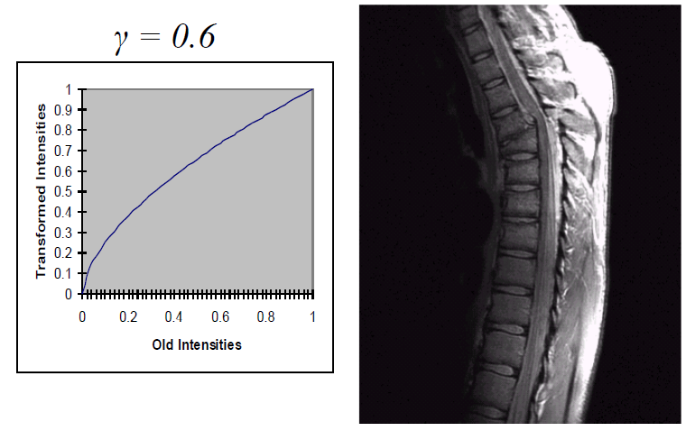
Power law example
lab 1
Explanation

Slide 19
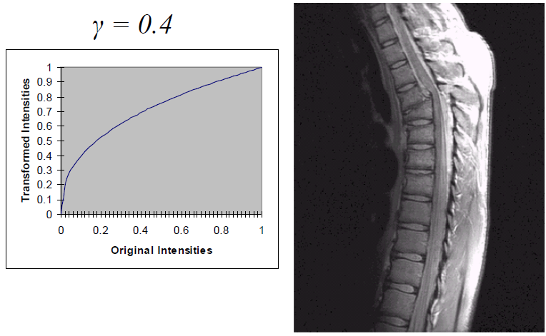
Power law example
lab 1
Explanation

Slide 20
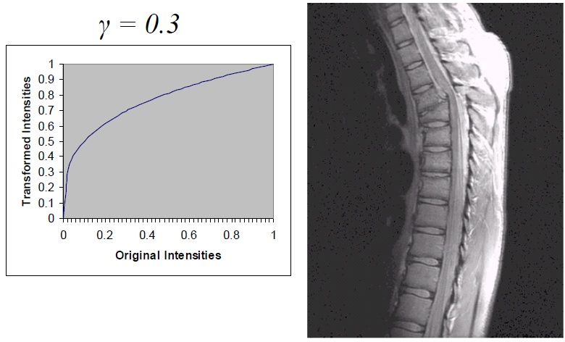
Power law example
lab 1
Explanation

Slide 21
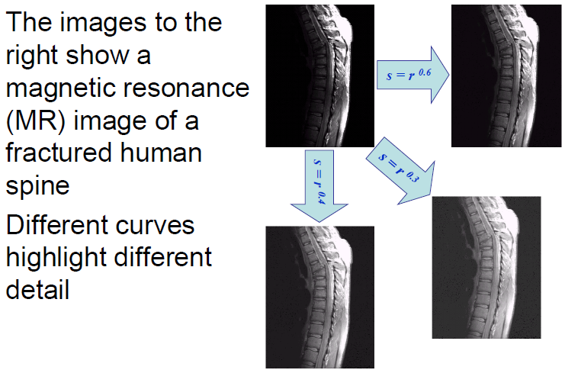
Power law example
lab 1
Explanation

Slide 22
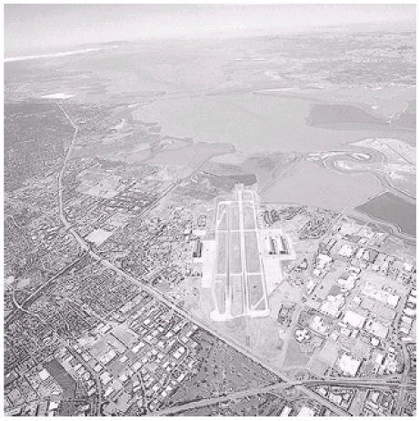
Power law example
lab 1
Explanation

Slide 23
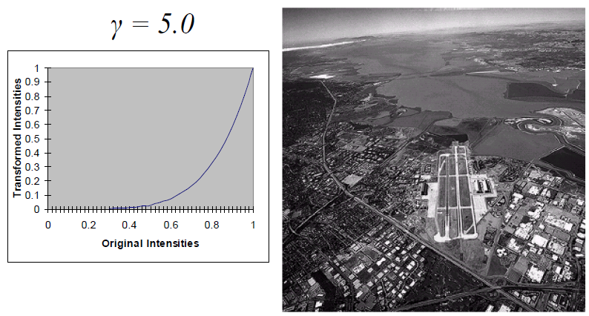
Power law example
lab 1
Explanation

Slide 24
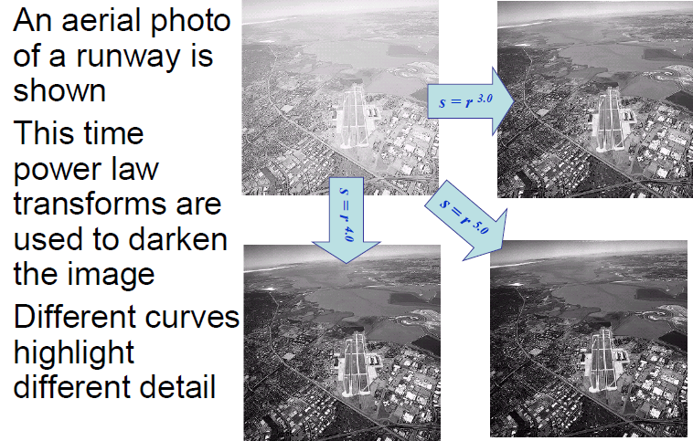
Power law example
lab 1
Explanation

